Slide 1

Type 1 Diabetes SNP Portal
By Team Microsoft Edge

Slide 2

Introduction
Type 1 diabetes mellitus (T1D) is an autoimmune disorder that results in the loss of insulin-producing pancreatic beta cells in genetically predisposed individuals, ultimately resulting in insulin deficiency and hyperglycaemia. (Nyaga et al., 2018)
Genome-wide association studies (GWAS) have identified a large number of genetic variants, or SNPs (single nucleotide polymorphisms) that confer higher susceptibility to T1D mostly in the HLA system.
Other genetic loci (non-HLA )are believed to influence population-level risk for T1D, although it is poorly understood how these contribute to disease susceptibility (Ram et al., 2016).

Slide 3
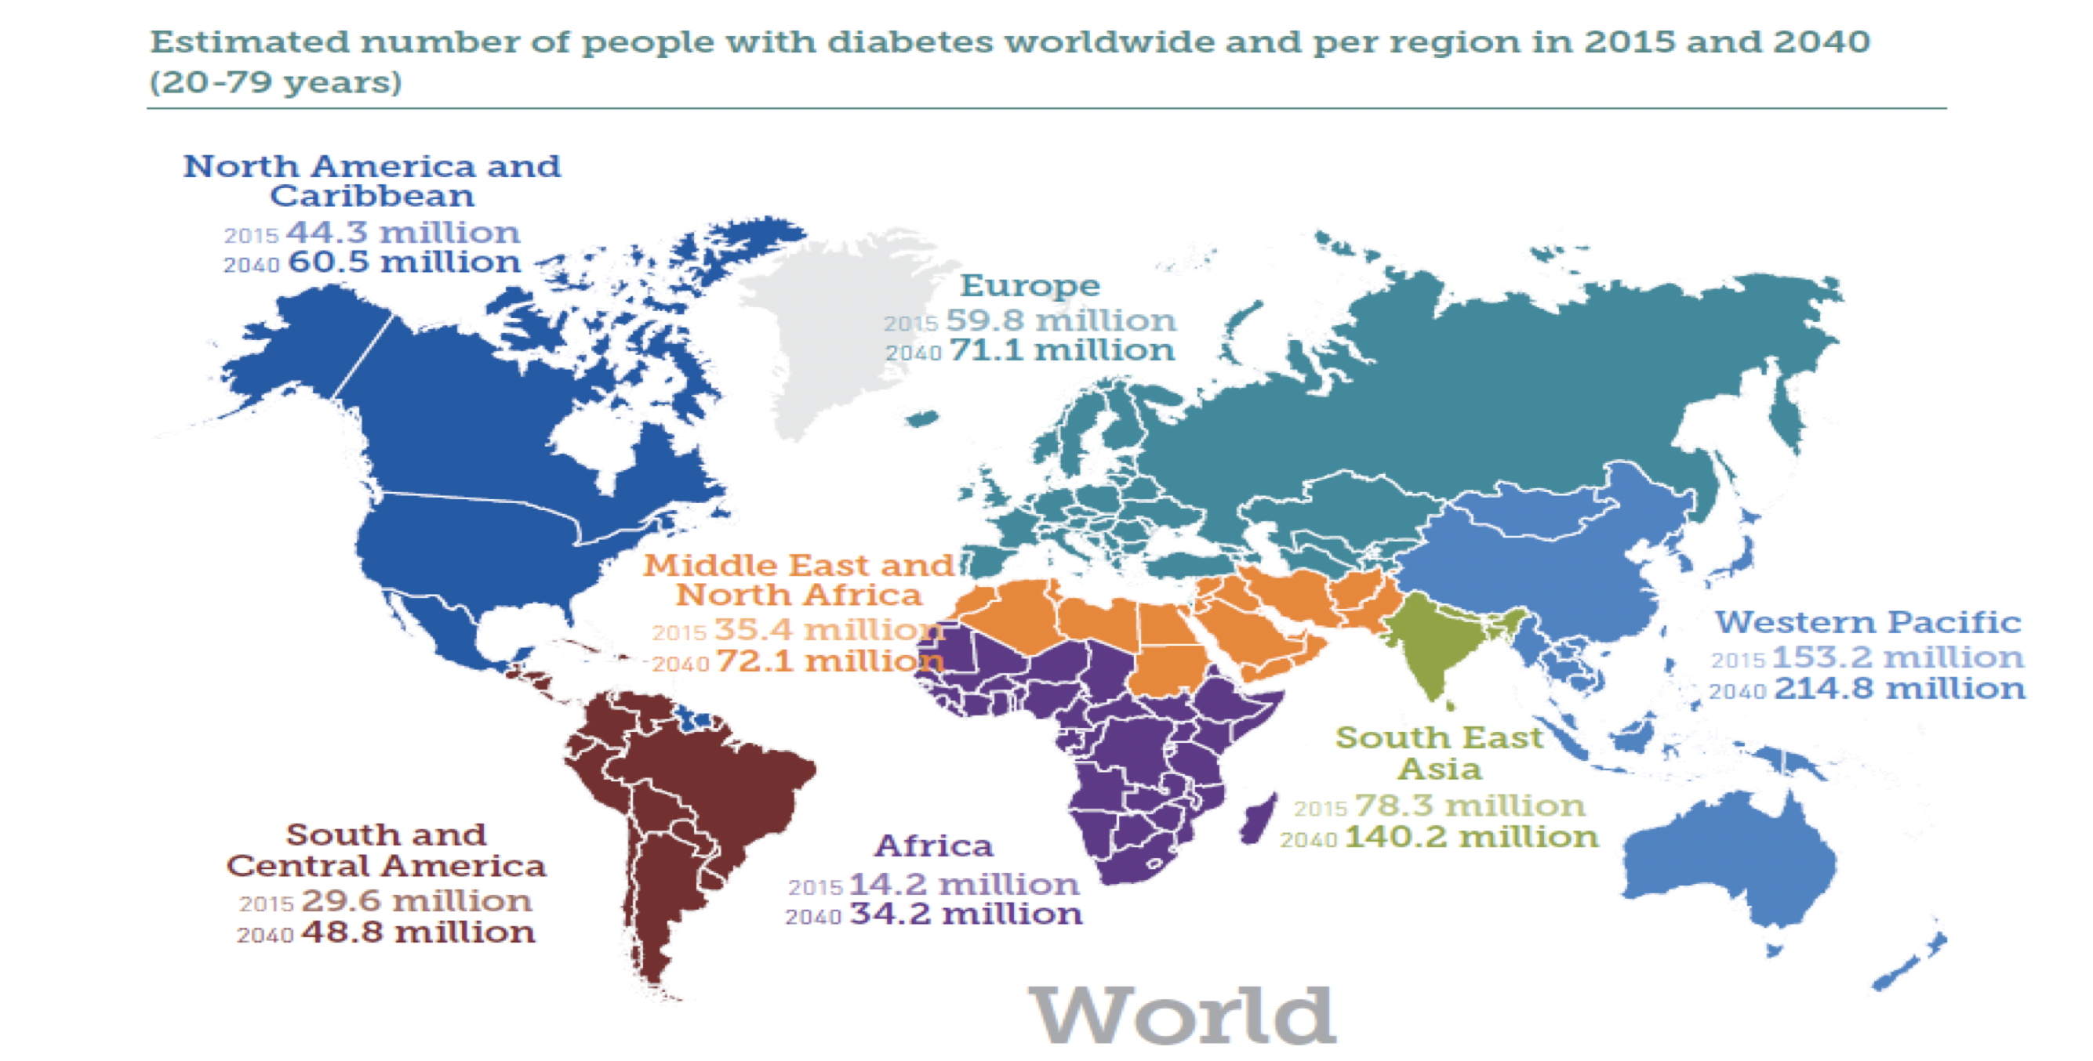
Global Burden of Diabetes
IDF Diabetes Atlas, 2015

Slide 4
Population
There is population level genetic variation that can be identified by analyses of microsatellite loci and the quantitative evaluation of allelic frequencies (Witherspoon et al., 2007).
Selected populations:
British
Han Chinese
Yoruba
Reasons:
Differences in T1D prevalence (low, medium and high) in the 3 populations.
Availabiity of GWAS data for each population

Slide 5
Project Significance
Rationale:
It is necessary to develop a web browser that leverages upon all the genomic, functional, and clinical information that properly interprets the mapping of the genetic basis of T1D.
Aims:
To build a web application that can retrieve genomic information of variants from all known associations to T1D and integrate them with population and functional information.
To produce informative plots and analyses using variant information.

Slide 6
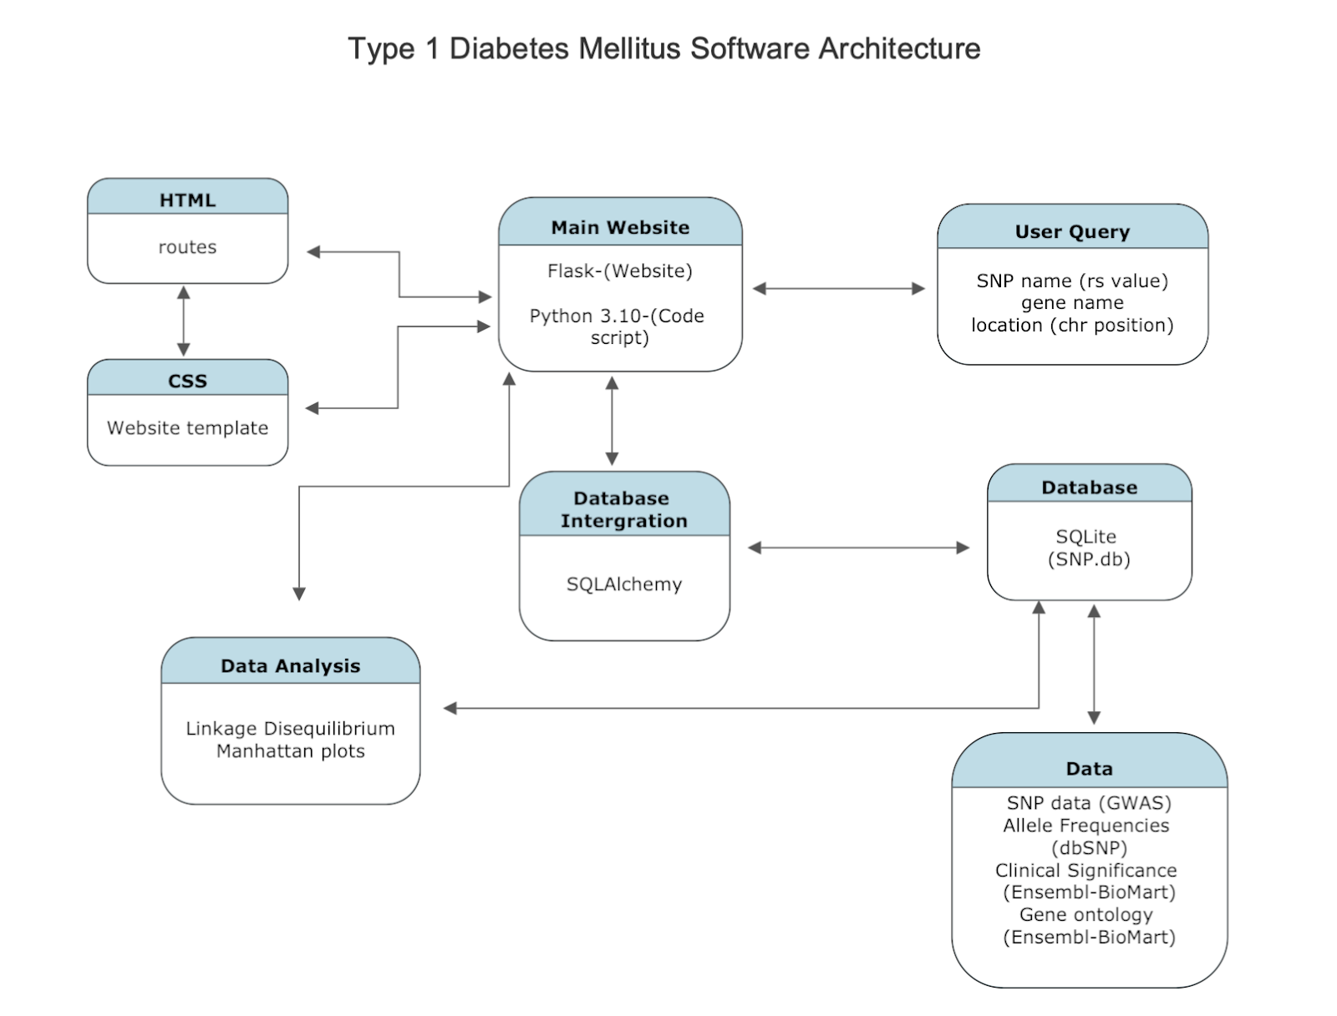
Software Architecture

Slide 7
Data Sources
Variant information (SNPs)
Clinical/ Functional data
Allele Frequencies
Gene Ontology data

Slide 8
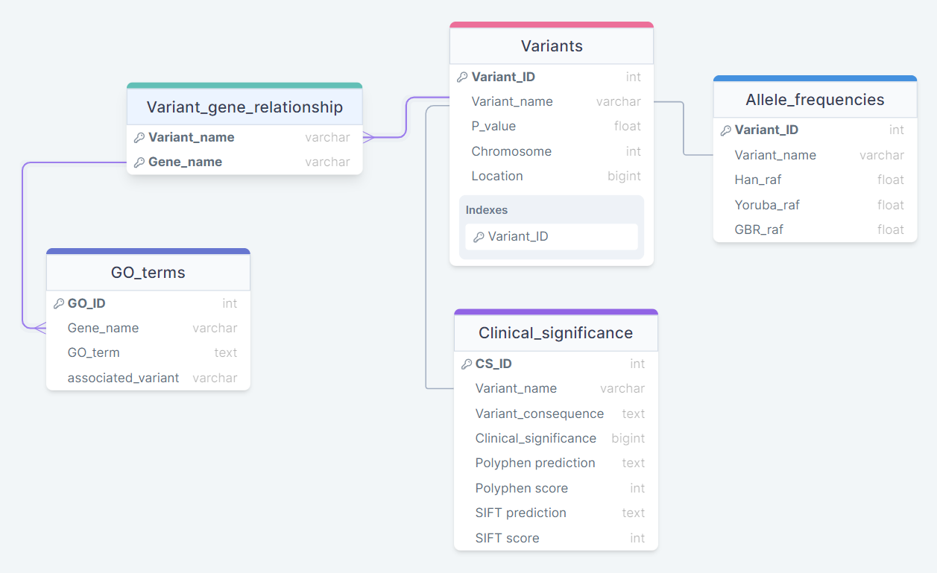
Database Schema

Slide 9
Website Backend
Alex to add

Slide 10
Data Analysis
Statistical summary used for LD and Manhattan plots

Slide 11
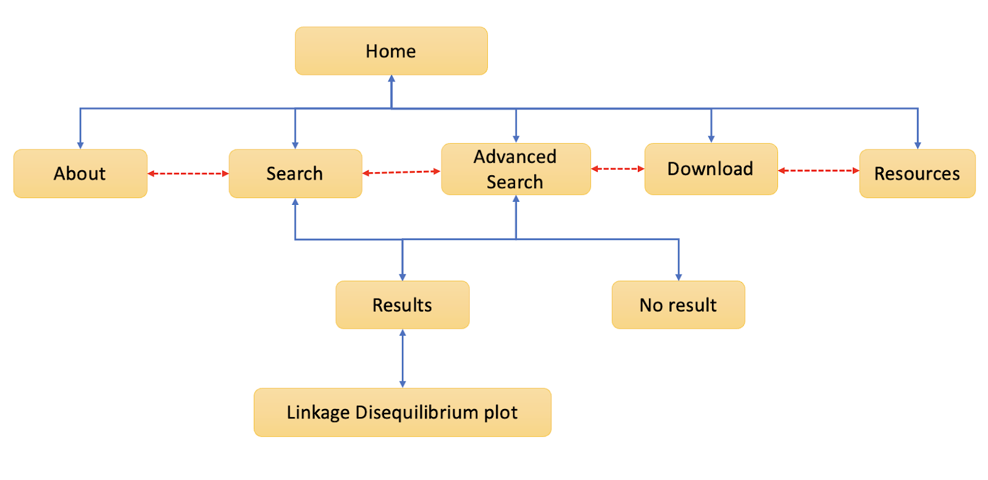
Website Frontend Overview

Slide 12
Website Demo

Slide 13
Limitations & Recommendations
Use of API to create the database
Limited functional and clinical data
Backend limitations

Slide 14
Conclusion

Slide 15
References
Nyaga DM, Vickers MH, Jefferies C, Perry JK, O'Sullivan JM. The genetic architecture of type 1 diabetes mellitus. Mol Cell Endocrinol. 2018 Dec 5;477:70-80. doi: 10.1016/j.mce.2018.06.002. Epub 2018 Jun 18. PMID: 29913182.
Ramesh Ram, Munish Mehta, Quang T. Nguyen, Irma Larma, Bernhard O. Boehm, Flemming Pociot, Patrick Concannon, Grant Morahan; Systematic Evaluation of Genes and Genetic Variants Associated with Type 1 Diabetes Susceptibility. J Immunol 1 April 2016; 196 (7): 3043–3053. https://doi.org/10.4049/jimmunol.1502056
D J Witherspoon, S Wooding, A R Rogers, E E Marchani, W S Watkins, M A Batzer, L B Jorde, Genetic Similarities Within and Between Human Populations, Genetics, Volume 176, Issue 1, 1 May 2007, Pages 351–359, https://doi.org/10.1534/genetics.106.067355

Slide 16





Team Microsoft Edge
01
Fatema Hajizadah
Alexandre E. Fraser
02
04
Peter Ulijaszek Scott
Lynnette N. Bhebhe
03

Slide 17



Acknowledgements
Superivisors:
Prof Conrad Bessant
Dr Matteo Fumagalli

Slide 18

Thank you

